Slide 1

Non-linear effect of energy commodites on USD exchange rate:
Evidence from oil and natural gas.
Seminar in Applied Financial Economics by Professor Reitz
Josef Fella and Robert Hennings
Christian-Albrechts-University of Kiel
josef.fella@stu.uni-kiel.de and robert.hennings@stu.uni-kiel.de
GitHub: https://github.com/RobertHennings
Kiel - 14.11.2025

Slide 2



Beginning: Newspaper article about energy + recent USD
Newspaper article on the price of gasoline and petrol going higher Stock Photo – Alamy, 08.10.2025
https://www.forbes.com/sites/siladityaray/2022/08/29/us-dollar-hits-two-decade-high-heres-what-that-means/, 08.10.2025
Energy Crisis and Fuel Gas Price Newspaper on Table Stock Illustration - Illustration of fossil, global: 270150690, 08.10.2025

Slide 4
Chapter 3)
Literature Review

Slide 5
The relationship between Energy Commodity Prices and exchange rates: Transmission channels¹
Datafrequency
Daily, Weely, Monthly
Monthly, Quarterly
Annually
Timeframe
Short Run Dynamics
Mid-term fluctuations
Long Run Relationship
Relationship Type
Financial Transmission Channels
Macroeconomic Transmission Channels
Fundamental Transmission Channels
Linear
Wealth Transfer Effect
(Risk Parity) Portfolio Rebalancing Effect
Monetary Policy
Present Value Approach
Inflation
Expectation Effects
Oil export and import
Denomination (Numeraire) Effect
Commodity Currencies
Dominant Pricing Effect
Non-Linear
Volatility and Risk Spillover Effects
(US) Terms of Trade Effect
Financialization Effects
Oil price shock affecting exchange rate through two channels (see impact of oil shocks Markov Switching)
Notes:
Sources:
1) Own illustration based on The relationship between oil prices and exchange rates: Revisiting theory and evidence
(Energy Economics 88 (2020) 104772), pages 3-8.

Slide 6
Chapter 4)
Theoretical Framework

Slide 7
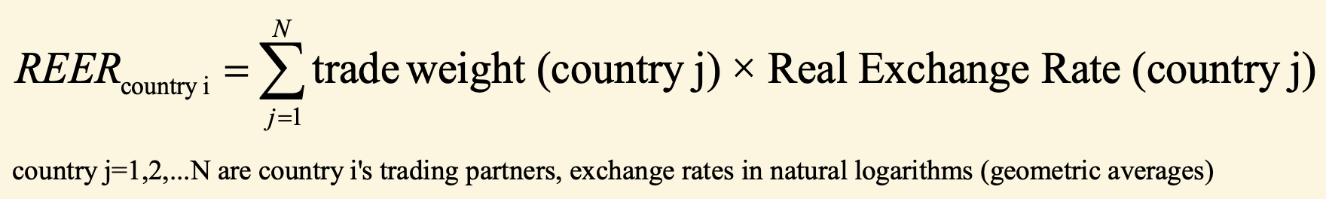
Definitions – What are prices and how are they measured?
Trade weight
Trade weight = manufacturing trade flows, weighting pattern is time-varying on a three-year basis²
Nominal Effective Exchange Rates (NEER)
NEER = geometric trade-weighted averages of bilateral exchange rates.²
64 economies, since 1994
Multilateral Basket of currencies
Real Effective Exchange Rates (REER)
REER =
Broad Index²
Inflation/Relative Consumer Prices²
Price variables:¹
GDP deflator
Unit labor costs
Narrow Index²
Nominal Exchange Rates
(NER)
NER = Domestic Price / Foreign Price or Foreign Price / Domestic Price¹
Real Exchange Rates
(RER)
RER = NER x Foreign Prices / Domestic Prices¹
Real exchange rates in external terms: CPI/PPI
Bilaterail currencies
Consumer prices
Producer prices
Real exchange rates in internal terms/terms of trade: Ratio tradable and non-tradable goods
26/27 economies
Spot or Futures Markets (prices)
Export prices
Nominal Energy commodity prices
Real Energy commodity prices
Spot or Futures Markets (prices)
Notes:
Sources:
https://www.bis.org/ifc/events/6ifcconf/takats_pres.pdf
https://data.bis.org/topics/EER

Slide 8
Definitions – What are prices and how are they measured?
No. | Exchange Rate | Basket | Data Frequency | Data availability | Exchange Rate Type | Bilateral or Multilateral | Source | Data ID | Link
1 | Real effective exchange rate | broad | monthly | starting from 1994-01 | REER | Multilateral | BIS | M.R.B.US | https://data.bis.org/topics/EER/BIS,WS_EER,1.0/M.R.B.US
2 | Real effective exchange rate | narrow | monthly | starting from 1964-01 | REER | Multilateral | BIS | M.R.N.US | https://data.bis.org/topics/EER/BIS,WS_EER,1.0/M.R.N.US
3 | Nominal effective exchange rate | broad | monthly | starting from 1994-01 | NEER | Multilateral | BIS | M.N.B.US | https://data.bis.org/topics/EER/BIS,WS_EER,1.0/M.N.B.US
4 | Nominal effective exchange rate | narrow | monthly | starting from 1964-01 | NEER | Multilateral | BIS | M.N.N.US | https://data.bis.org/topics/EER/BIS,WS_EER,1.0/M.N.N.US
5 | Nominal effective exchange rate | narrow | daily | starting from 1983-10-03 | NEER | Multilateral | BIS | D.N.N.US | https://data.bis.org/topics/EER/BIS,WS_EER,1.0/D.N.N.US
6 | Nominal effective exchange rate | broad | daily | starting from 1996-04-11 | NEER | Multilateral | BIS | D.N.B.US | https://data.bis.org/topics/EER/BIS,WS_EER,1.0/D.N.B.US
7 | USD-EUR Spot Rate | - | daily | starting from 1999-01-04 | NER | Bilateral | FRED | DEXUSEU | https://fred.stlouisfed.org/series/DEXUSEU
8 | Nominal Broad U.S. Dollar Index | broad | daily | starting from 2006-01-02 | NEER | Multilateral | FRED | DTWEXBGS | https://fred.stlouisfed.org/series/DTWEXBGS
9 | Real Broad Dollar Index | broad | monthly | starting from 2006-01-01 | REER | Multilateral | FRED | RTWEXBGS | https://fred.stlouisfed.org/series/RTWEXBGS
Notes:
Sources:
https://www.bis.org/ifc/events/6ifcconf/takats_pres.pdf
https://data.bis.org/topics/EER

Slide 9
A simple model of exchange rates and energy commodity prices
Heavily affect importing and exporting economies
Fundamental
Shock
Adjusted Future Expectations for Demand-Supply Levels
(Spot) Price Adjustments
Increased
Volatility
Inflationary Pressure driving up prices
Monetary Policy:
Rate Hikes
Interest Rate Differentials
Parity Conditions
(PPP/UIP/CIP)
Derived proxy variables
Identify regimes
CBOE Crude Oil ETF Volatility Index
Crude Oil WTI Front Month Future Price
Crude Oil WTI Spot Price
Transmission depending on degree of financial integration
Open Interest in oil futures markets¹
Notes:
Sources:
1) See Paper: Oil prices, exchange rate and asset prices („open interest in the oil futures market, i.e. the number of open futures contracts (as a proxy for the financialisation of the oil market).
“), page 2.
Own illustration based on The relationship between oil prices and exchange rates: Revisiting theory and evidence
(Energy Economics 88 (2020) 104772), pages 3-4.

Slide 10
Theoretical Framework
1)
Identify relevant regimes in the data
Theoretically affecting crisis periods - major global shocks¹
No. | Period | Event
1 | 2007 – 2009 | Global Financial Crisis: A systemic financial collapse (mortgage bagged securities) that disrupted global financial systems.
2 | 2010 – 2012 | European Debt Crisis: A period of sovereign debt instability affecting the Eurozone.
3 | 2014 – 2016 | Oil Price Crash: A sharp decline in crude oil prices driven by oversupply and geopolitical tensions.
4 | 2020 – 2021 | COVID-19 Pandemic: A global health crisis that caused unprecedented disruptions in supply chains and demand patterns.
5 | 2022 – present | Russia-Ukraine Conflict: An ongoing geopolitical conflict with significant implications for energy and agricultural markets.
N_{min} = 5 vs. N = 2 (high vola and low vola)
Alternative approaches: N > 2
Classical approaches: N = 2
Include relevant exogeneous variables
Benchmark models
Variable | Thematic Area to capture
Futures Trading Open Interest | Degree of Financial Integration
Futures Trading Volume | Degree of Financial Integration
VIX Index | Volatility
Markov Switching
STR/STAR Model
2)
Analyze and compare the regimes
Notes:
Sources:
1) List of theoretically affecting crisis periods taken from: How Exchange Rate Volatility Shapes Commodity Derivatives Market: Lessons from Five Global Shocks (2007–2023), page: 2.

Slide 11
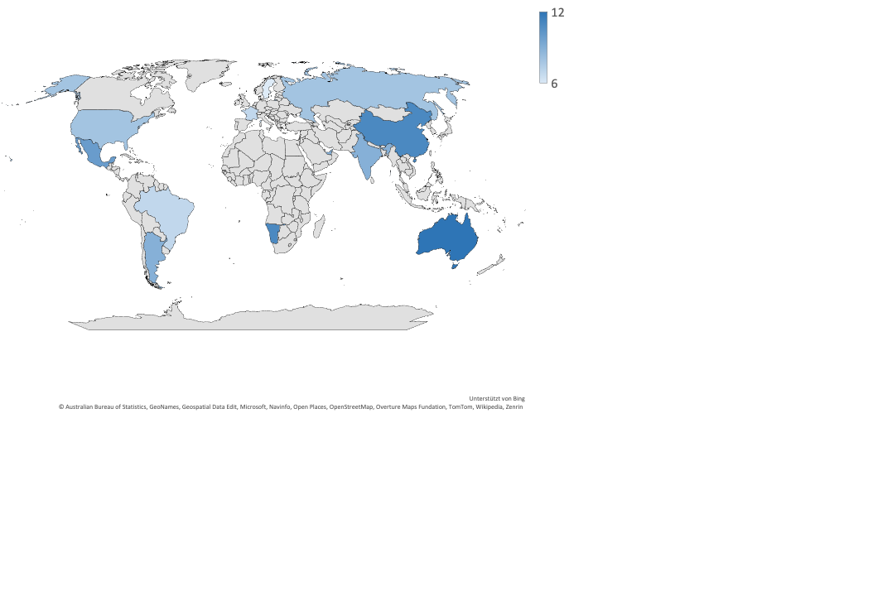
A simple model of exchange rates and energy commodity prices

Slide 12
Chapter 5)
Methodology Overview

Slide 13
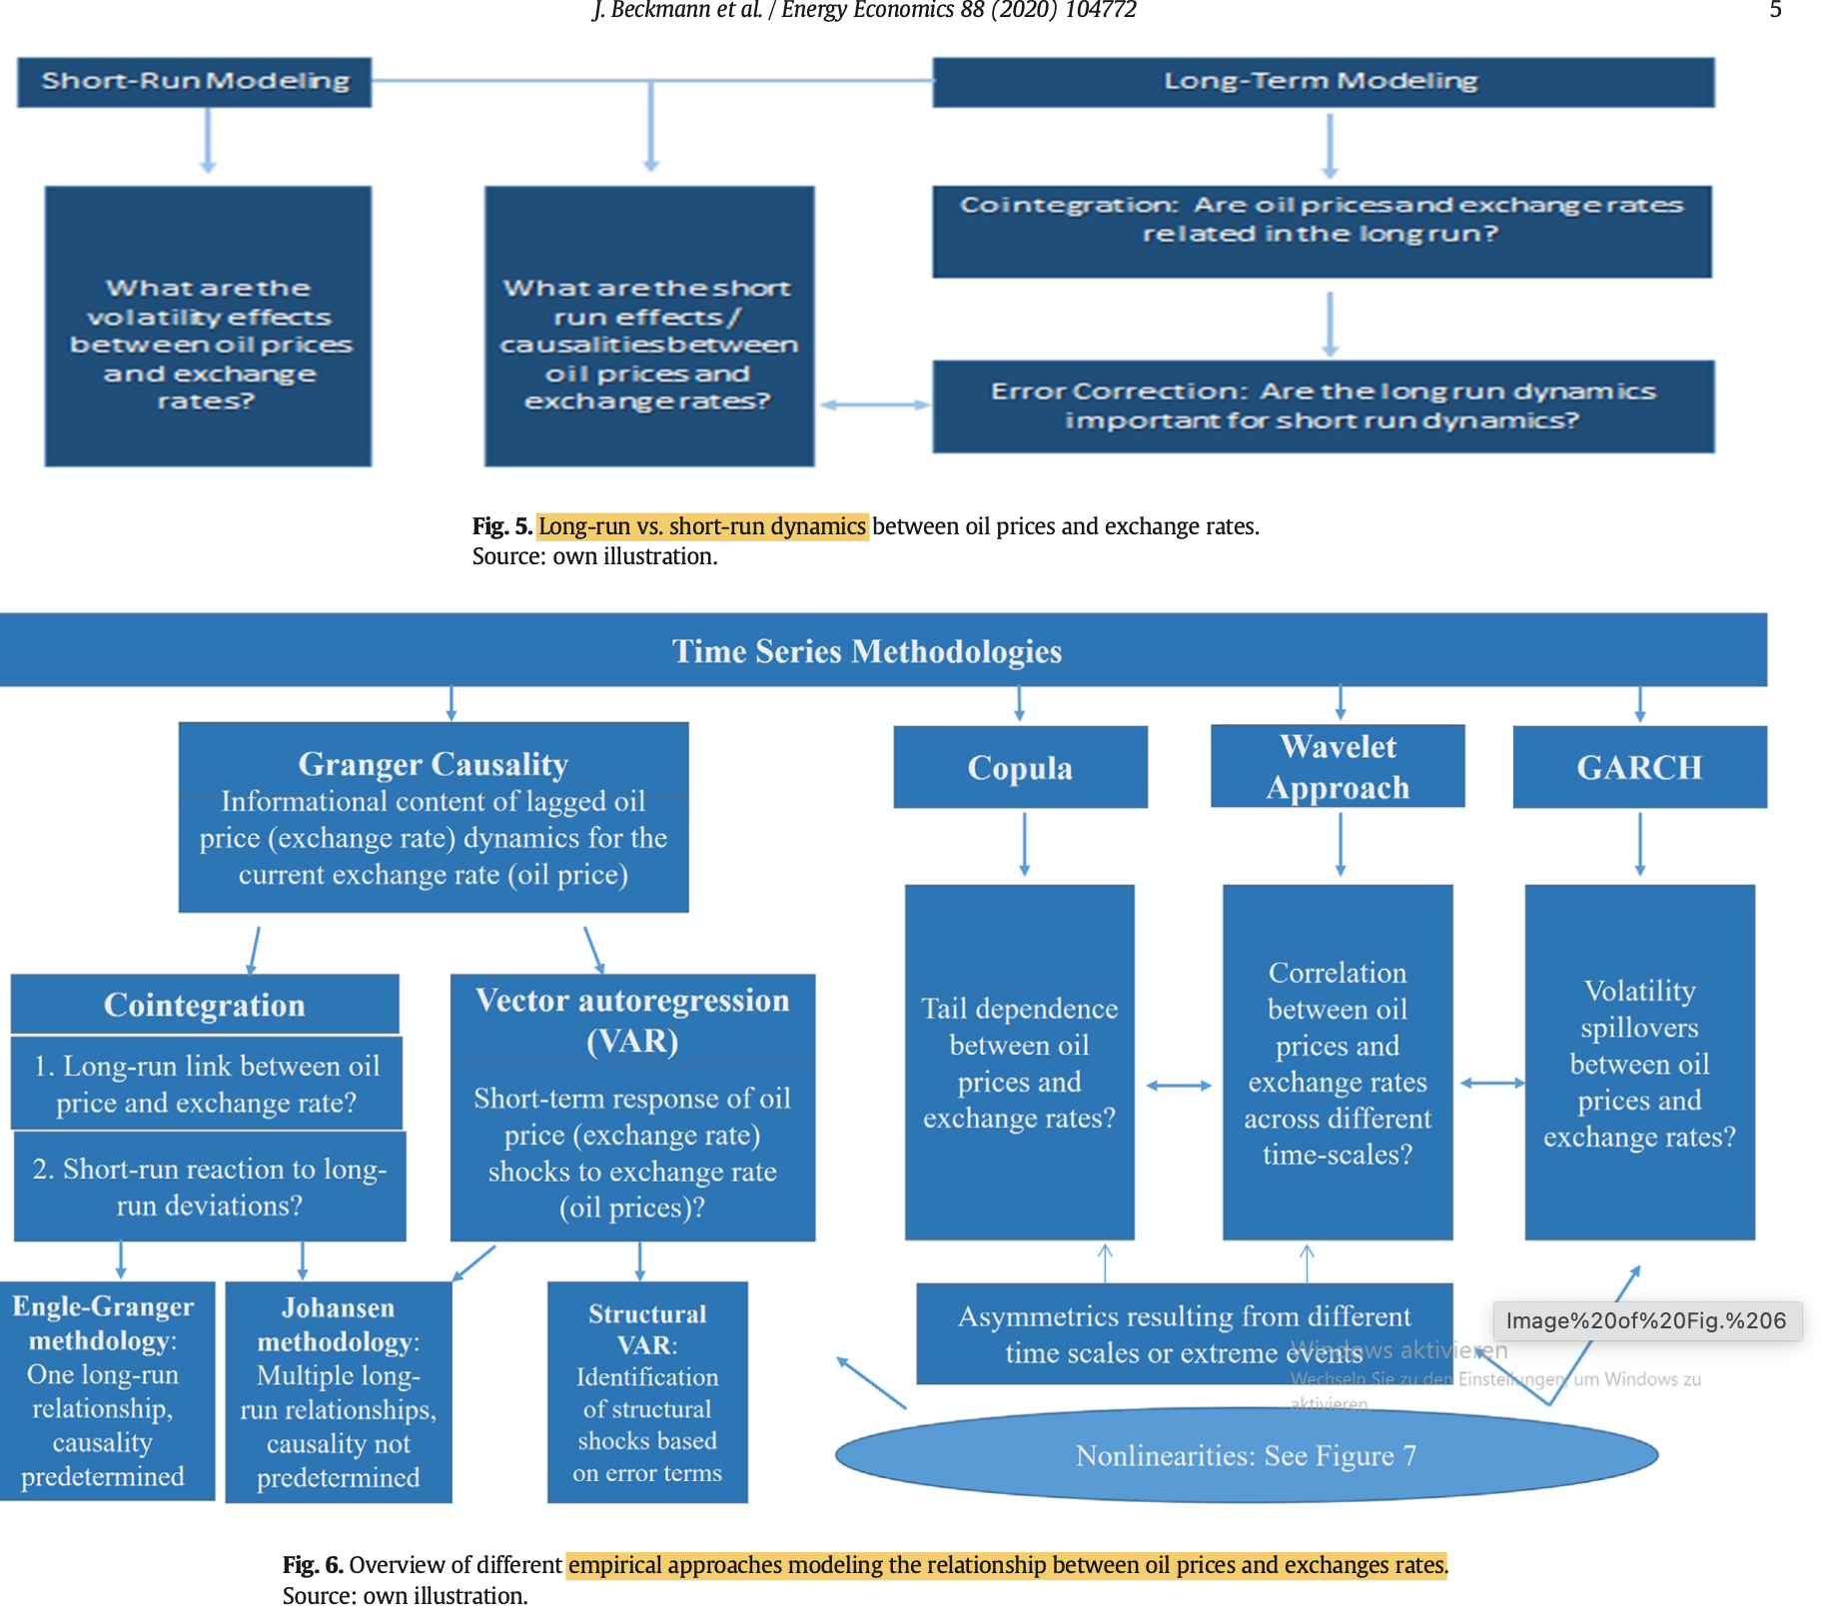
The relationship between Energy Commodity Prices and exchange rates: Transmission channels
Datafrequency
Daily, Weely, Monthly
Monthly, Quarterly
Annually
Timeframe
Short Run Dynamics
Mid-term fluctuations
Long Run Relationship
Relationship Type
Financial Transmission Channels
Macroeconomic Transmission Channels
Fundamental Transmission Channels
Linear
Wealth Transfer Effect
(Risk Parity) Portfolio Rebalancing Effect
Monetary Policy
DCC - GRACH
SVAR
Inflation
VAR
Expectation Effects
Oil export and import
Denomination Effect
Commodity Currencies
Dominant Pricing Effect
Non-Linear
Volatility and Risk Spillover Effects
(US) Terms of Trade Effect
Notes:
Sources:
Own illustration based on The relationship between oil prices and exchange rates: Revisiting theory and evidence
(Energy Economics 88 (2020) 104772), pages 3-8.

Slide 14
The relationship between Energy Commodity Prices and exchange rates: Econometric modelling
Relationship Type
Linear
Non-linear
Timeframe
Relationship
Correlation
When we find a certain relationship we can proceed further
Linear Pearson Correlation
Non-linear rank correlation
Granger-Causality
Rolling Correlation
ECM
Time-varying causality
Regime Switching
Clustering techniques
Markov-Switching
MS-VAR
DCC - GRACH
Long Run Relationship
SVAR
Cointegration
Connectedness
VAR
VECM
Vector Autoregression (VAR)
Notes:
Sources:
Own illustration based on The relationship between oil prices and exchange rates: Revisiting theory and evidence
(Energy Economics 88 (2020) 104772), pages 3-8.

